Slide 1
GE Power – Margin Analysis
May 2018
TCS Confidential

Slide 2

Business Understanding
Objective
Predict the Optimal selling price of part
Identify the Customer buying behavior and frequency
Predict likelihood of a customer to buy

Slide 3

Approach – Pricing Analysis
Methodology
Part Segmentation
Behavior Segmentation
Price Influencer
What products and parts they buy
What parts and products they buy together
What order source is prefered to buy the product
Demographics
Order Source
RFM Parameters
Whether they are discount seeker
How much they spend
How frequently they buy
Predicted Price
Data
Data
Data
Products and Parts Offered
Discount
Region Data
~17k
~17k
~17k
Customer Details
Buy Frequency
419
419
419
Sources,Carrier Details
Overall Spend
233
Part Segment
Behavior Segment
RFM Score
171
44

Slide 4

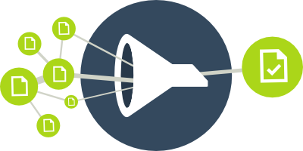
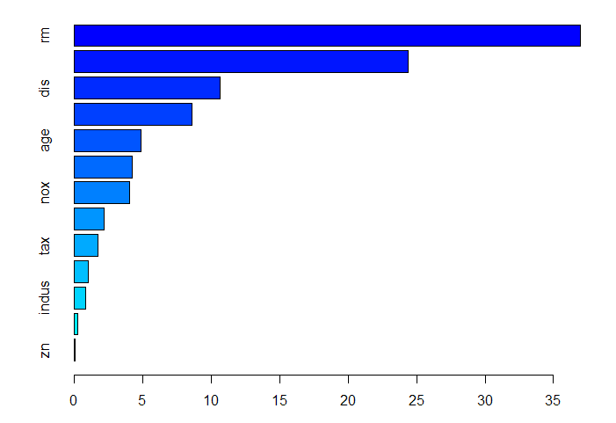


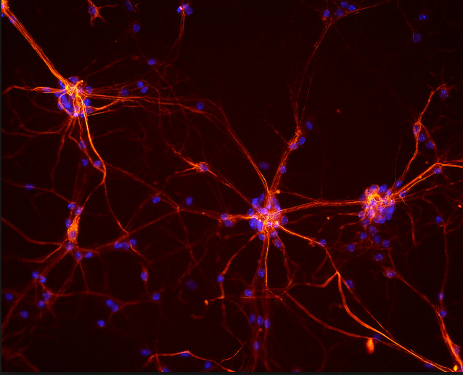
Pricing Analysis: Machine Learning Prediction Process
Pricing Details
List Price
Contribuion Margin
Discount
State
Quantity
Order Source
Selling Price
Select Feature by high correlation with response variable.
ANOVA - Categorical to Continuous
Chi Square - Categorical to Categorical
Multi-collinearity detection and treatment
1.Data Base Details
3.Target Variable
5.Feature Extraction
Price Prediction
2.Data Cleansing &
Manipulation
4.Segmentation
6. Neural network
Segmentation analysis is the task of grouping a set of objects in such a way that objects in the same group are more similar to each other than to those in other groups.
K mode clustering for Qualitative variables.
K means clustering for Quantitative variables.
Screen plot to get the number of cluster.
Neural networks, a beautiful biologically-inspired programming paradigm which enables a computer to learn from observational data.
The process is, Initialize Network -> Forward Propagate ->Back Propagate Error ->Back Propagate Error ->Predict
Missing imputation
Outlier treatment
Variable transformation

Slide 5

Selling Price Decision - Background
bjective
To predict the Optimal Selling for the parts
Data Used
103 total variables, 15 key variables used for analysis.
13088 total number of transactions.
Values with List Price = 0 were removed (3 Values)
All observatios are belonging to the years between 2015 and 2017.
111 Unique Master customers
106 total unique parts
Statez | No. Of Transactions | Total Revenue
TX | 2903 | 23.18
IL | 1401 | 8.22
OK | 745 | 6.97
IA | 724 | 4.33
KS | 689 | 4.87
NE | 635 | 4.39
CO | 526 | 4.45
MI | 412 | 4.57
WY | 370 | 2.90
ND | 363 | 2.04
Quantity v/s Margin
 | Only 1 | <3 | >3
Below 70% | 32% | 31% | 20%
70%-85% | 38% | 36% | 28%
Above 85% | 30% | 34% | 52%
Texas has highest number of transactions (2903) and generates maximum revenue
(23.18 Millions).
52% of the transactions with quantity per order of more than 3 have a Contribution Margin of Above 85%

Slide 6
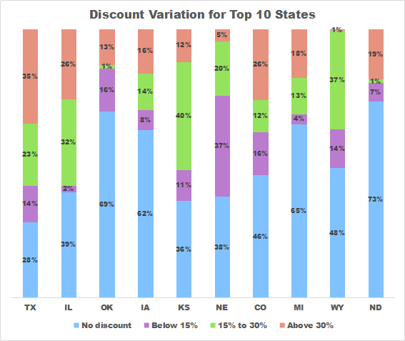
Data Insights
Discount v/s Frequency
 | Only 1 | 1 to 20 | Above 2 0
No Discount | 69% | 63% | 3%
Below 15% | 13% | 28% | 50%
15% -30% | 6% | 2% | 30%
Above 30% | 13% | 8% | 17%
69% of the Master Customers with an annual frequency of 1 transaction get No Discount.
30% of the Master Customers with an annual frequency of above 20 transactions get an average discount of between 15% to 30%
Discount v/s Quantity
 | Only 1 | Less than 3 | More than 3
No Discount | 47% | 44% | 38%
Below 15% | 13% | 13% | 13%
15% -30% | 21% | 21% | 16%
Above 30% | 19% | 22% | 33%
47% of the transactions with 1 Quantity bought per order get No discount
33% of the transactions with more then 3 Quantity bought per order get Above 30% discount.
Discount v/s Order Source
 | Online | Order Capture Quotes | IStore Account | Copy | GERE SO Conversion
No Discount | 39% | 70% | 50% | 60% | 38%
Below 15% | 12% | 24% | 17% | 8% | 25%
15% -30% | 21% | 2% | 17% | 14% | 25%
Above 30% | 28% | 4% | 16% | 18% | 13%
50% of the transactions done through Istore Account Order Source get No discount.
28% of the transactions done through Online Order Source get Above 30% Discount
35% of the transactions in Texas have Above 30% Discount.
73% of the transactions in North Dakota get No discount

Slide 7



Behaviour Segmentation Insights
Segment | Count | % of Count | Total Annual Revenue
Potential Customers | 84 | 76% | 9.60
Frequent Customers | 24 | 22% | 11.09
Loyal Customers | 2 | 2% | 10.52
76% of the Master Customers belong to Segment 1
2% of the Master Customers contribute to 34% of the annual revenue
|Buying Potential
Potential Customers
Frequent Customers
Loyal Customers
Annual Revenue:
83% of the accounts generate less than $1.5Million revenue per annum
Discount Offered:-
68% of the accounts get No Discount
Contribution Margin:-
Margin is above 85% for 53% of the customers
Annual Revenue:
54% of the accounts generate more than $1.5Million revenue per annum
Discount Offered:-
42% of the accounts get Upto 30% Discount
Contribution Margin:-
Margin is between 70 % to 85% for 39% of the customers
Annual Revenue:
100% of the accounts generate more than $1.5Million revenue per annum
Discount Offered:-
38% of the accounts get Above 30% Discount
Contribution Margin:-
Margin is below 70% for 32% of the customers

Slide 8
Behaviour Segmentation Insights
|Buying Patterns
Potential Customers
Frequent Customers
LoyalCustomers
Frequency:
82 % of the accounts have Upto 20 transactions in a year.
Quantity Ordered:-
40% of the customers order a quantity of only 1 per order.
Frequency:
54% of the accounts have between 20 to 600 transactions in a year
Quantity Ordered:-
34% of the customers order a quantity of upto 3 per order.
Frequency:
100% of the accounts have more than 600 transactions in a year.
Quantity Ordered:-
38% of the customers order a quantity of more than 3 per order.
|Buyer’s Placement
Potential Customers
Frequent Customers
Loyal Customers
State:
32% of the accounts belong to Nebraska ,Wyoming and Missouri
Order Source:-
52% of the accounts order on the Istore Source
State:
30% of the accounts belong to IIllinois Iowa, and Kansas.
Order Source:-
50% of the accounts order on the Online Source
State:
38% of the accounts belong to Texas and Oklahoma
Order Source:-
96% of the account order on the Online Source.

Slide 9
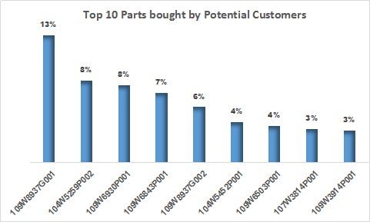
Profile -1 | Potential Customers
No. of Master Customer | 84
No. of Customers | 132
Total Revenue (MM$) | 9.06
Avg Discount % | ~2%
Avg Margin% | ~86%
Average Annual Frequency | 15
Total Transactions | 3927
76% of customers contribute to
30% of revenue
Top Revenue Generating Customers
Master Customer | Average Annual Frequency | Total Annual Revenue (MM$) | % of Cluster Revenue
TERRAFORM | 167 | 1.55 | 17%
NRG | 113 | 1.02 | 11%
PACIFICORP | 101 | 0.74 | 8%
BEPC | 64 | 0.62 | 7%
DTEENERGY | 32 | 0.58 | 6%
50% of the total Cluster Revenue is generated by Top 5 Customers.
Terraform generates the maximum revenue(1.55MM$) and has highest Average Frequency of transactions (167)in a year.
Top 10 parts have been bought in 57% of the transactions done by Potential customers.

Slide 10
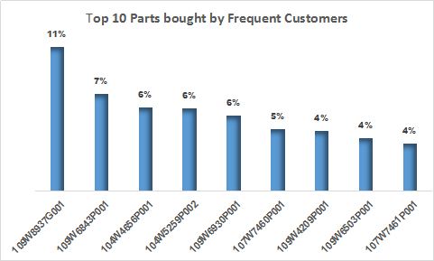
Profile -2 |Frequent Customers
No. of Master Customer | 24
No. of Customers | 83
Total Revenue (MM$) | 11.09
Avg Discount % | ~26%
Avg Margin% | ~73%
Average Annual Frequency | 62
Total Transactions | 4527
22% of customers conritbute to
36% of revenue
Top Revenue Generating Customers
Master Customer | Average Annual Frequency | Total Annual Revenue (MM$) | % of Cluster Revenue
EON | 270 | 1.93 | 17%
EDF | 279 | 1.88 | 17%
ENEL | 116 | 1.27 | 11%
AVANGRID | 33 | 1.07 | 10%
DUKE | 73 | 0.80 | 7%
63% of the total Cluster Revenue is generated by Top 5 Customers.
Eon generates the maximum revenue (1.93 MM$) but EDF has highest Average Frequency of transactions (279) in a year.
Top 10 parts have been bought in 53% of the transactions done by Frequent customers.

Slide 11
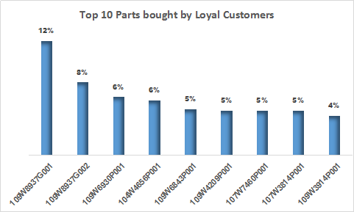
Profile -3 | Loyal Customers
No. of Master Customer | 2
No. of Customers | 138
Total Revenue (MM$) | 10.52
Avg Discount % | ~31%
Avg Margin% | ~68%
Average Annual Frequency | 770
Total Transactions | 4625
2% of Customers contribute to
34% of Revenue
Top Revenue Generating Customers
Master Customer | Average Annual Frequency | Total Annual Revenue (MM$) | % of Cluster Revenue
NEXTERA | 865 | 7.16 | 68%
INVENERGY | 676 | 3.36 | 32%
100% of the total Cluster Revenue is generated by 2 Master Customers.
Nextera generates the maximum revenue(7.16MM$) and has highest Average Frequency of transactions (865) in a year.
Top 10 parts have been bought in 56% of the transactions done by Frequent customers.

Slide 12
Parts Segmentation
Money Making Parts
54%(57) of Total Parts
Profitable Parts
10%(11) of Total Parts
Least bought Parts
36% (38) of Total Parts
Least bought Parts
36% (38) of Total Parts
Low Value Parts
10%(11) of Total Parts
Low Value Parts
54%(57) of Total Parts
Frequency:
100% of the parts have been bought more than 20 times in a year.
Annual Revenue:
100% of the parts generate more than 1.5 million revenue per annum
Quantity Ordered:-
44% of the parts are bought more than 3 times per order
Discount Offered:-
36% of the parts are sold at No Discount
Contribution Margin:-
Margin is above 85% for 48% of the parts
Item Type:-
88% of the parts are NEW Item type
Frequency:
47% of the parts have been bought only one time in a year
Annual Revenue:
47% of the parts generate less than $10000 revenue per annum
Quantity Ordered:-
46% of the parts are bought only 1 time per order
Discount Offered:-
35% of the parts are sold at upto 30% Discount
Contribution Margin:-
Margin is below 70% for 75% of the parts
Item Type:-
37% of the parts are CONV Item type
Frequency:
47% of the parts have been bought only one time in a year
Annual Revenue:
47% of the parts generate less than $10000 revenue per annum
Quantity Ordered:-
46% of the parts are bought only 1 time per order
Discount Offered:-
35% of the parts are sold at upto 30% Discount
Contribution Margin:-
Margin is below 70% for 75% of the parts
Item Type:-
37% of the parts are CONV Item type
Frequency:
44% of the parts have been bought less than 20 times in a year.
Annual Revenue:
44% of the accounts generate between $10000 to 1.5Million revenue per annum
Quantity Ordered:-
38% of the parts are bought between upto 3 times per order
Discount Offered:-
52% of the parts are sold at No Discount
Contribution Margin:-
Margin is between 70% to 85% for 43% of the parts
Item Type:-
59% of the parts are NEW Item type
Frequency:
44% of the parts have been bought less than 20 times in a year.
Annual Revenue:
44% of the accounts generate between $10000 to 1.5Million revenue per annum
Quantity Ordered:-
38% of the parts are bought between upto 3 times per order
Discount Offered:-
52% of the parts are sold at No Discount
Contribution Margin:-
Margin is between 70% to 85% for 43% of the parts
Item Type:-
59% of the parts are NEW Item type

Slide 13
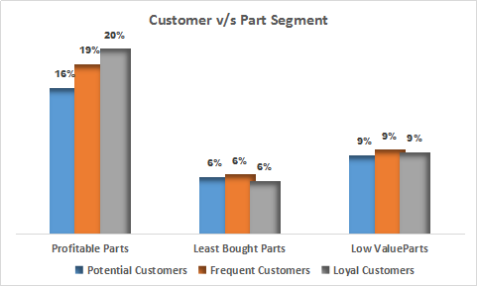
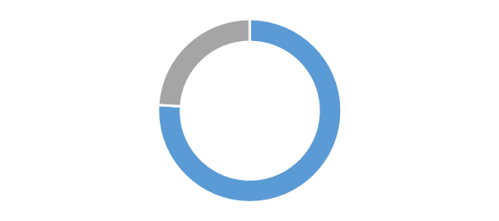

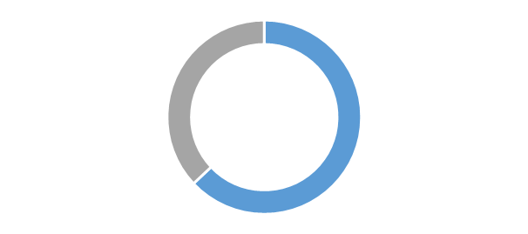
Customer v/s Part Analysis:Whom to Focus
Loyal Customers– Profitable Parts
Contribution to Total revenue
62%
Total Annual Revenue = 7 MM$
Total Master Customers =2 (~2%)
Total Customers =130(~38%)
Total Revenue 20 MM$ (62%)
TotalMaster Customers 102 (92%)
Total No. of Customers 322 (92%)
Total No. of Items 11(10%)
Frequent Customers – Profitable Parts
Total Annual Revenue = 7 MM$
Total Master Customers = 19 (~17%)
Total Customers =72(~21%)
Target Group
Potential Customers – Profitable Parts
Total Annual Revenue = 6 MM$
Total Master Customers = 81 (~73%)
Total Customers =120(~35%)
10%
Focus on 10% of parts generating maximum profit
20% of the total transactions fall into the segment of Profitable parts and Loyal Customers

